Slide 1
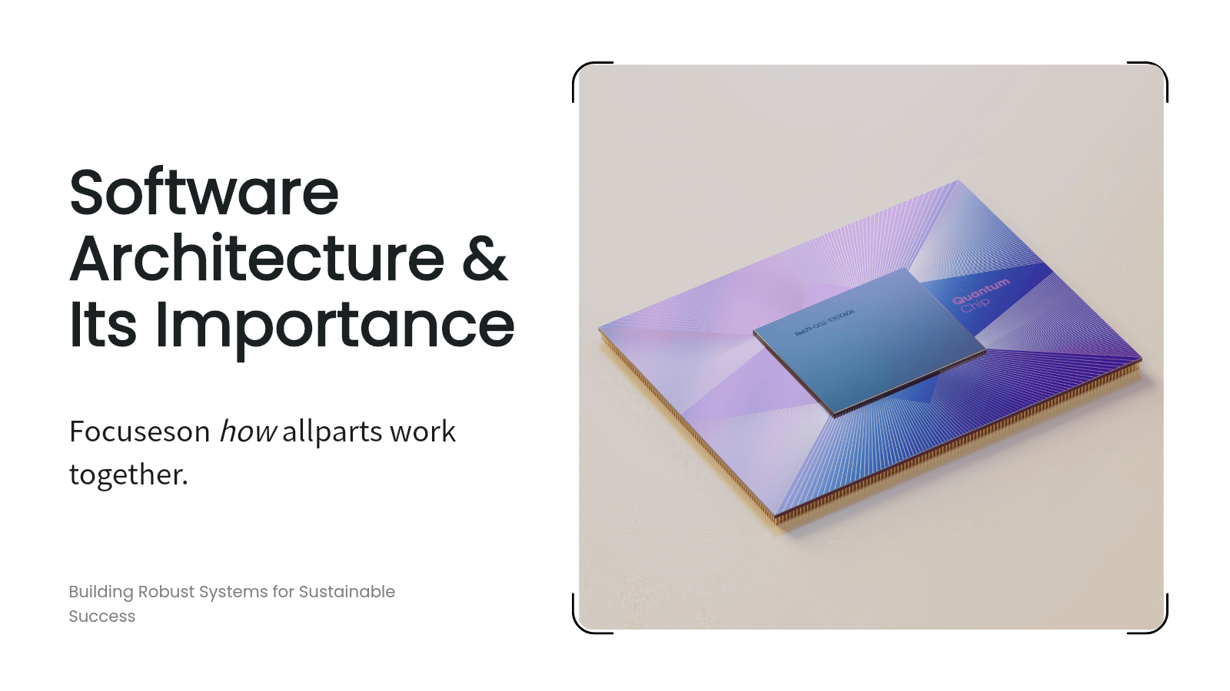

Slide 2
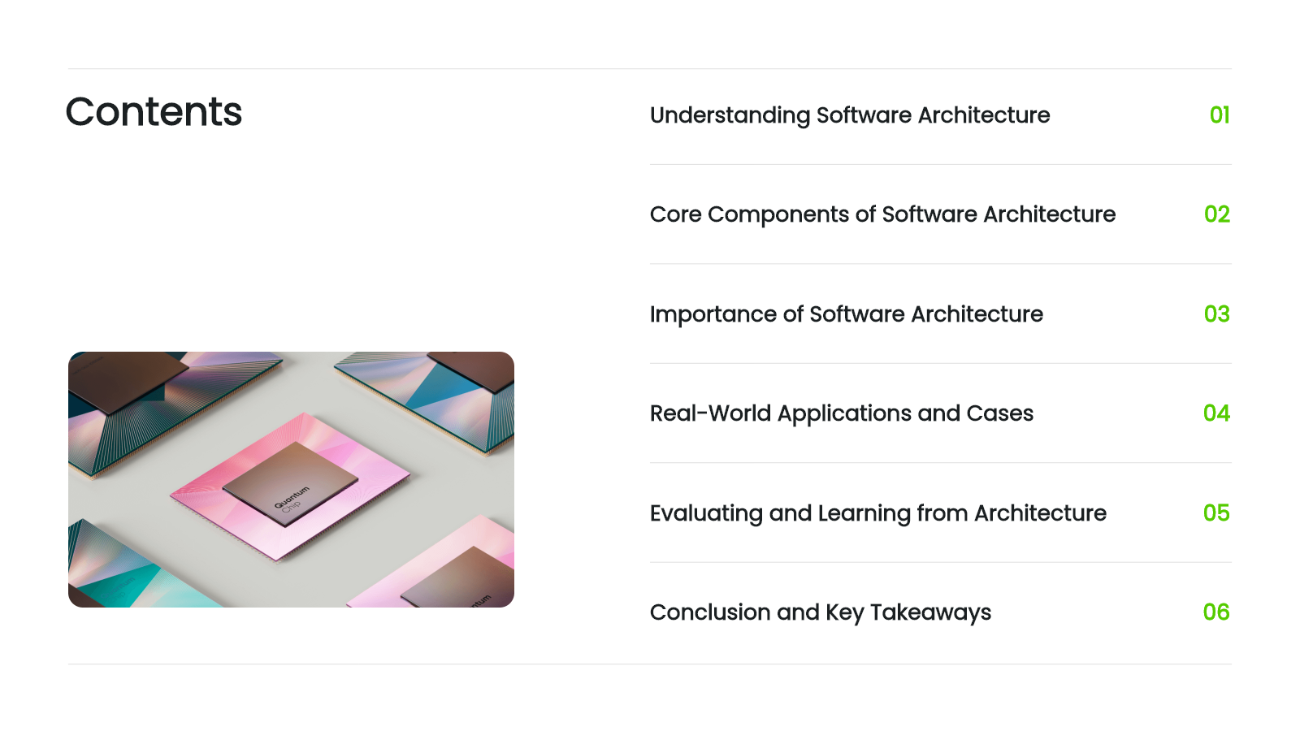

Slide 3
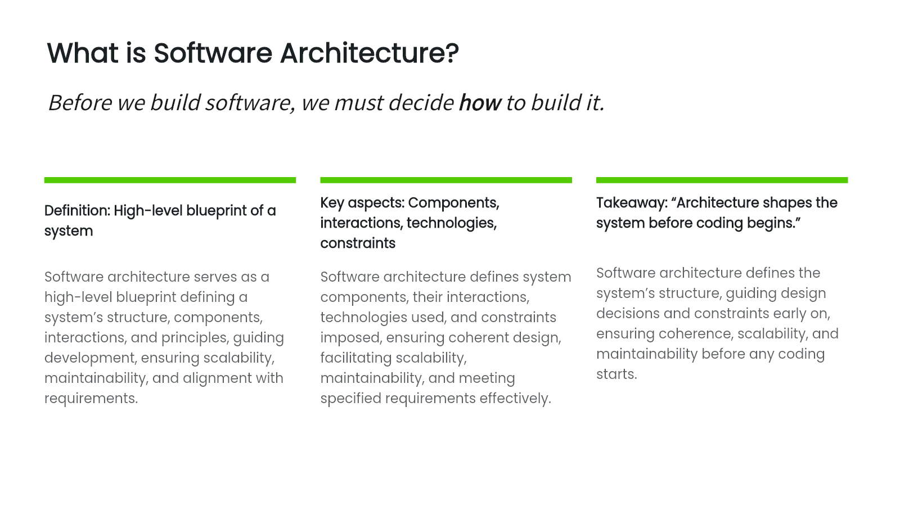

Slide 4
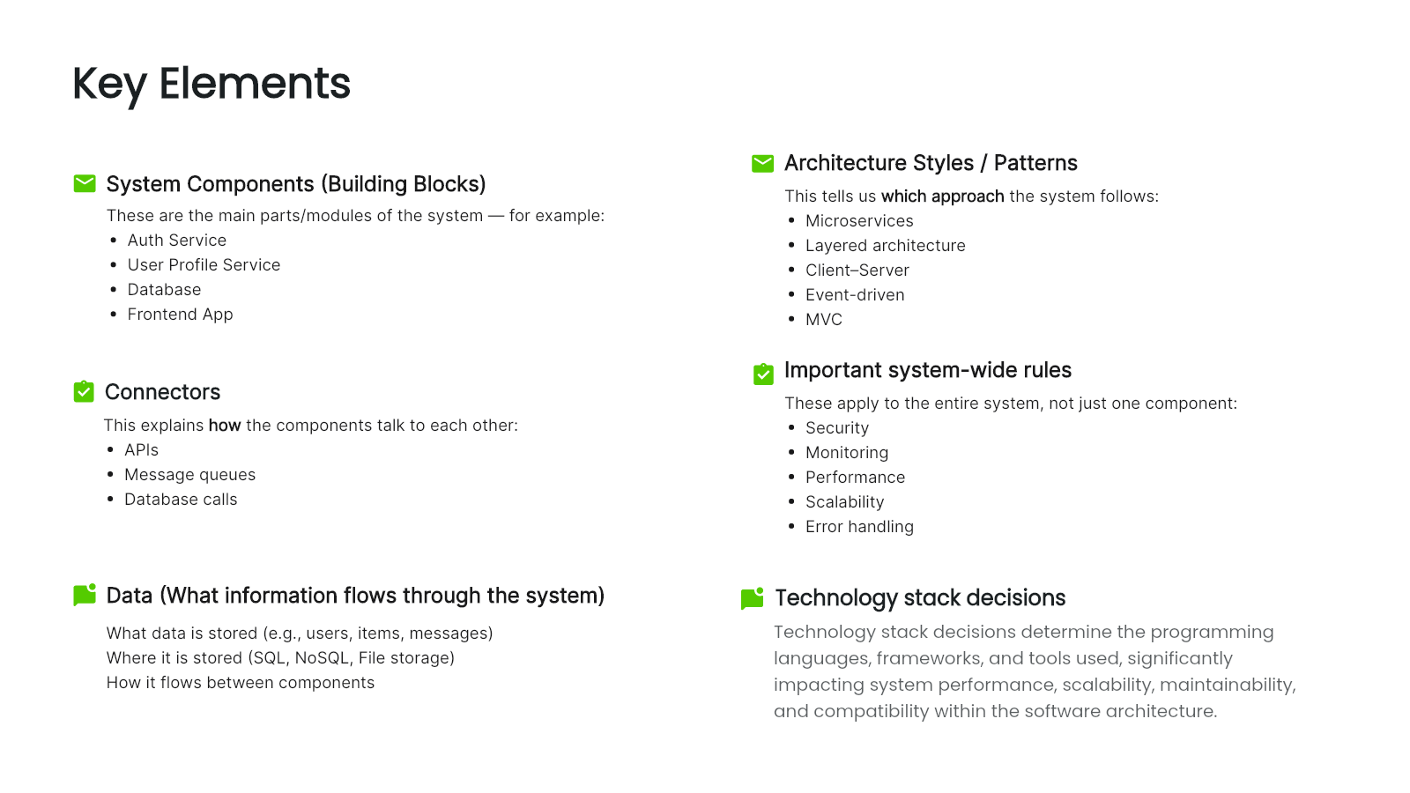

Slide 5
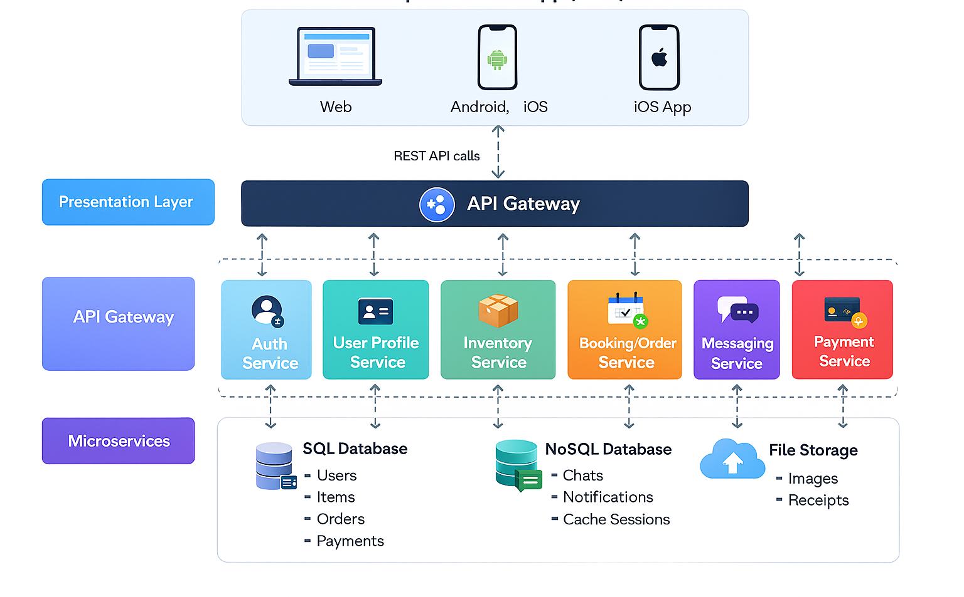

Slide 6


Slide 7
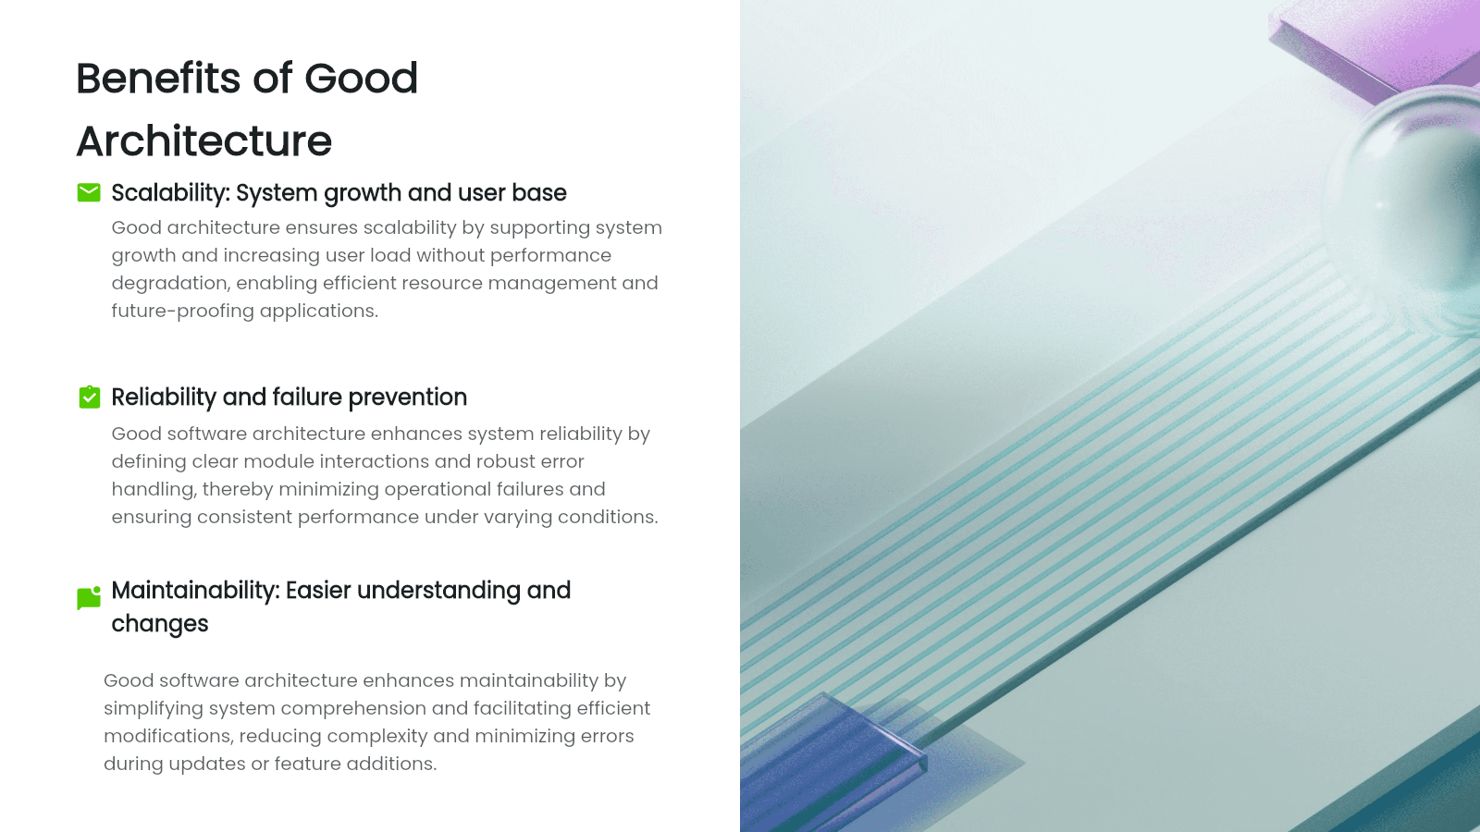

Slide 8
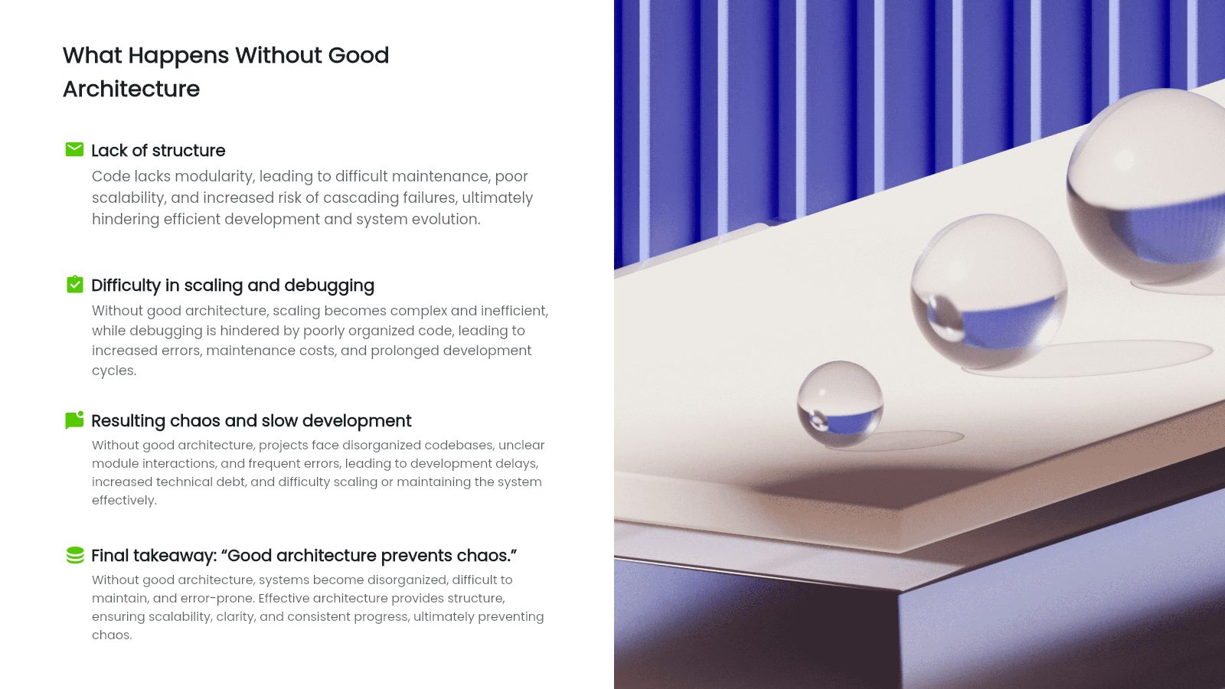

Slide 9
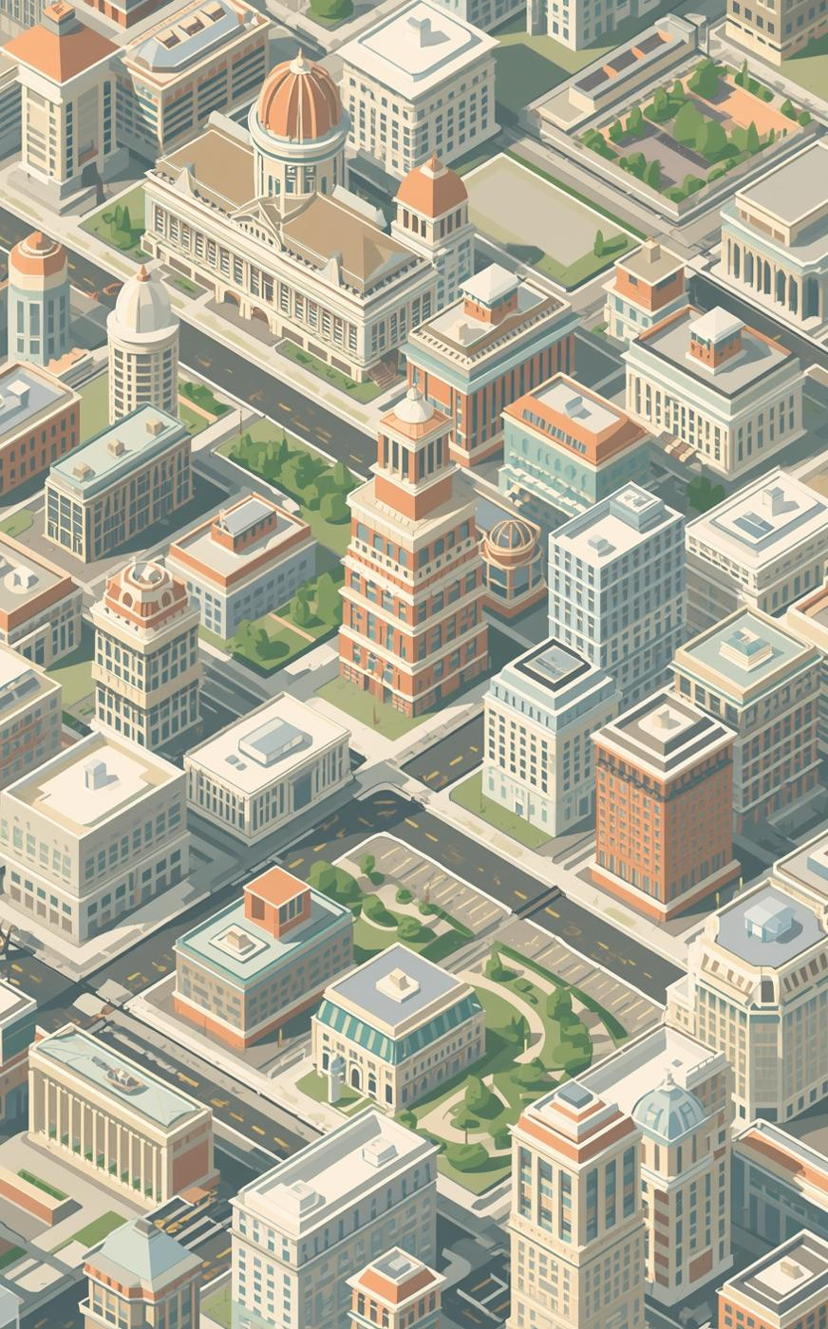

TECH INNOVATIONS INC.
Difference Between Software Architecture & Software Design

Slide 10
Architecture vs. Design
What comes to mind for you?

Slide 11
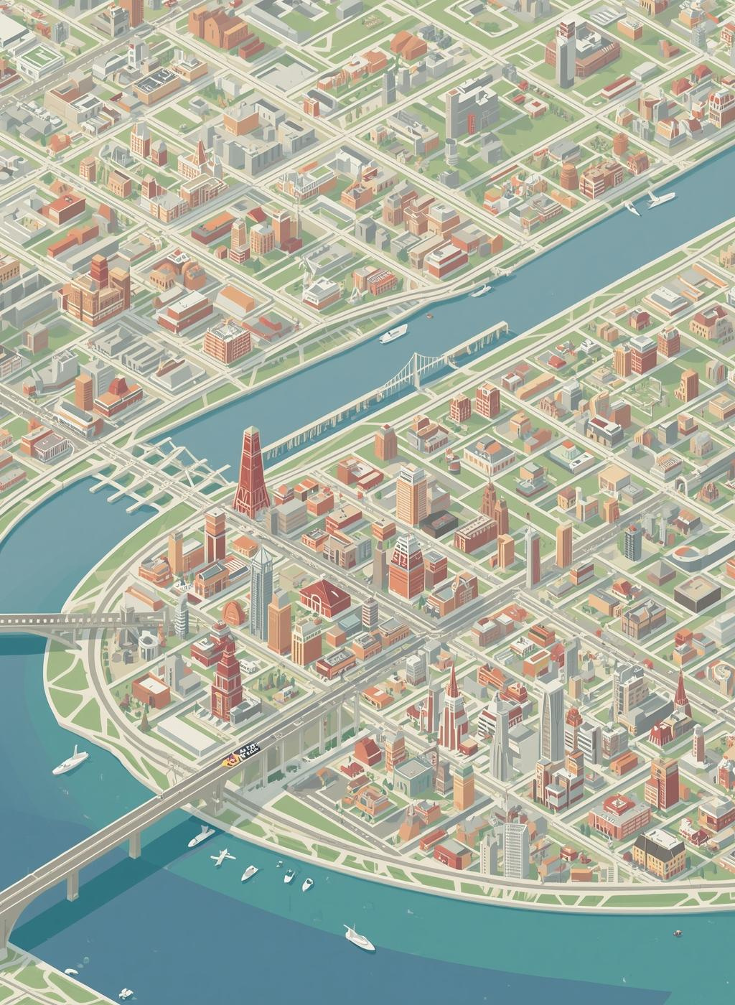
Architecture Analogy: City View
Overall Structure and Arrangement
Layout: How spaces are arranged (streets, buildings).
Flow: How people move through those spaces.
Interaction: How different parts of the environment connect and support activities.

Slide 12
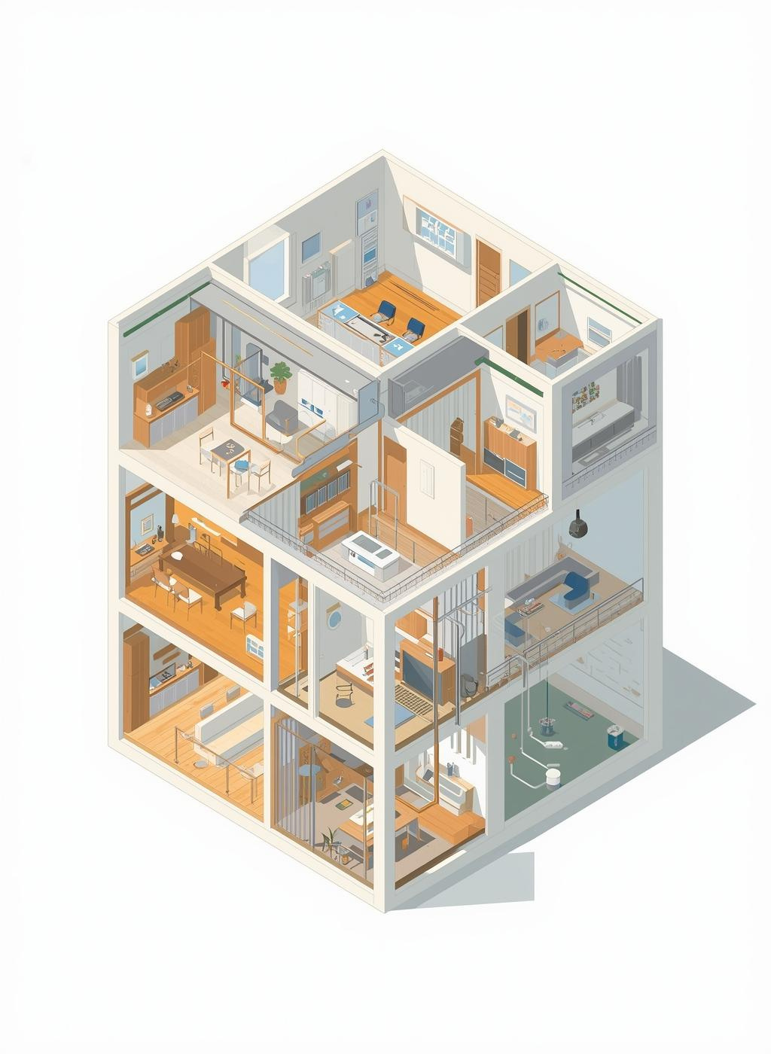
Design Analogy: Building Blueprint
Understanding Internal Component Creation
Blueprint: Shows internal structure and layout of a building (rooms, plumbing, wiring).
Design plan: Defines arrangement, aesthetics, and functional relationships of spaces.
Ensures harmony between elements like furniture, lighting, and decor.
Goal: Create a practical, efficient, and functionning environment

Slide 13
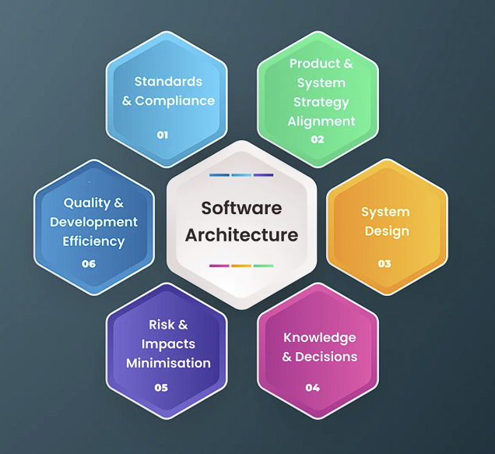
Software Architecture
Focuses on overall system structure and high-level organization.
Defines how components interact and communicate.
Ensures scalability, performance, and reliability of the entire system.
Concerned with frameworks, layers, and deployment strategies.
Example: Choosing microservices vs monolithic architecture for an application.

Slide 14
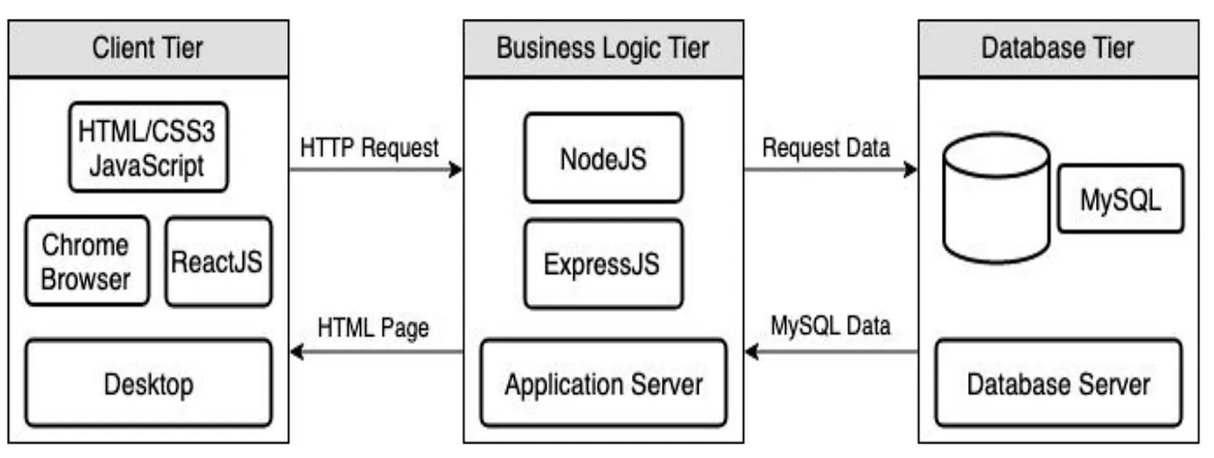

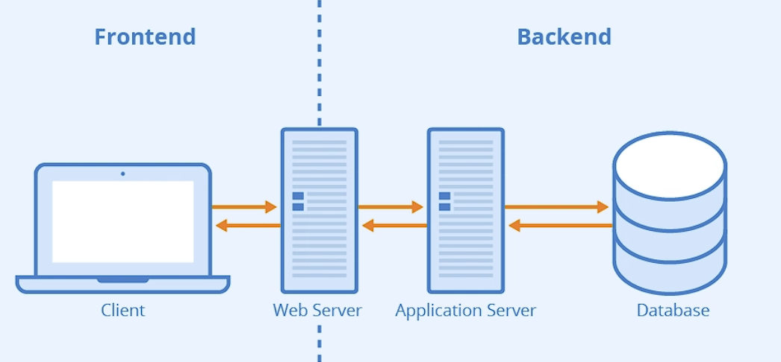
Website
Entire Website
Front-end
Back-end
DB
Server Side interactions
API’s

Slide 15

Software Design
Understanding Internal Components
Focuses on how individual components are implemented.
Deals with detailed structure: classes, functions, data flow.
Ensures logic, usability, and maintainability at the component level.
Concerned with patterns and best practices for coding.
Example: Deciding how a login module validates user credentials.

Slide 16

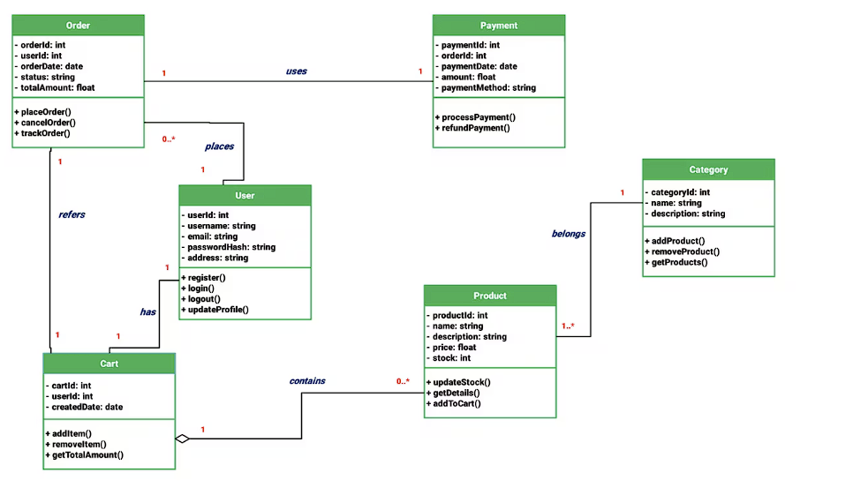


Slide 17
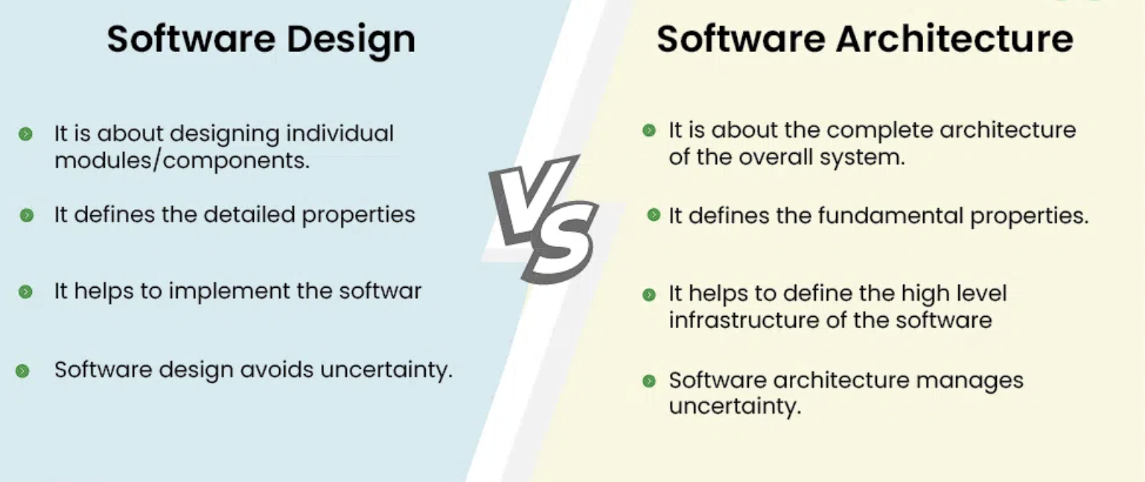

Slide 18
“Architecture is the blueprint of the system; design is the blueprint of the components.”

Slide 19
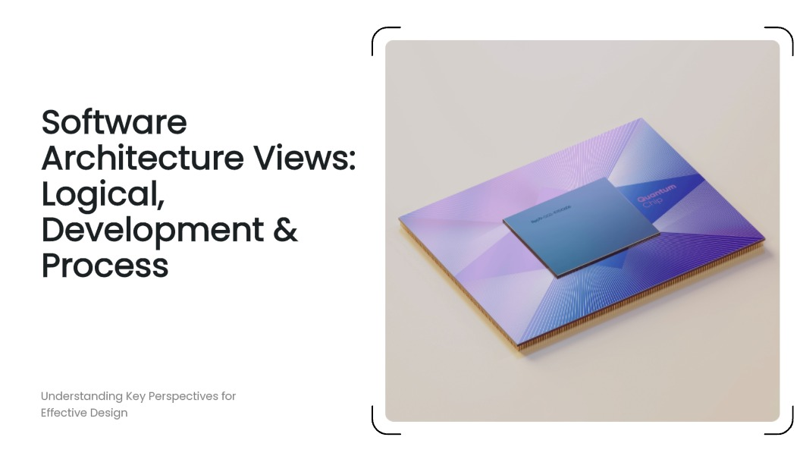

Slide 20
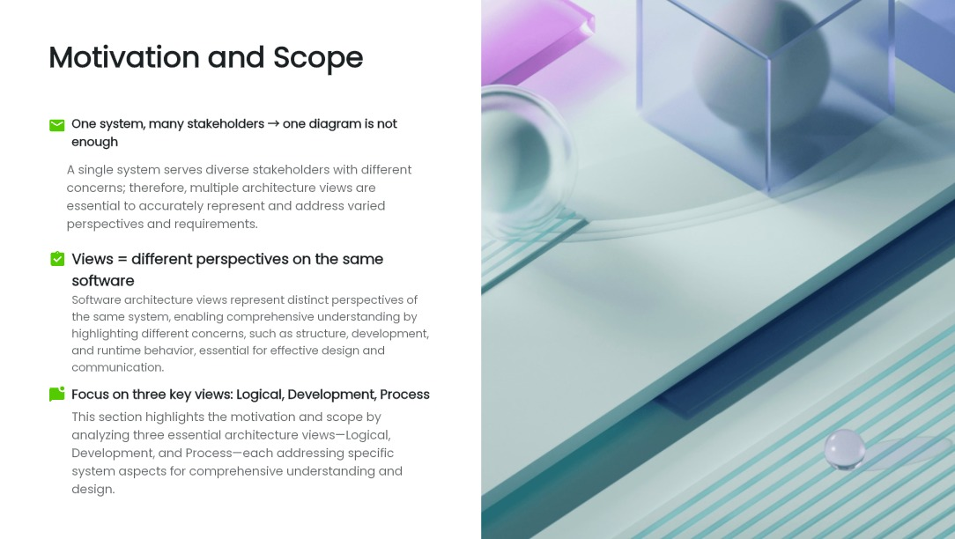

Slide 21
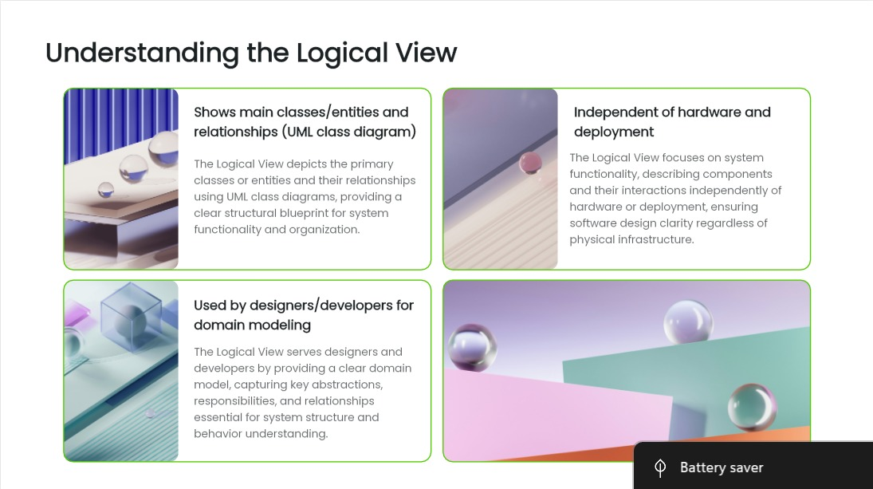

Slide 22
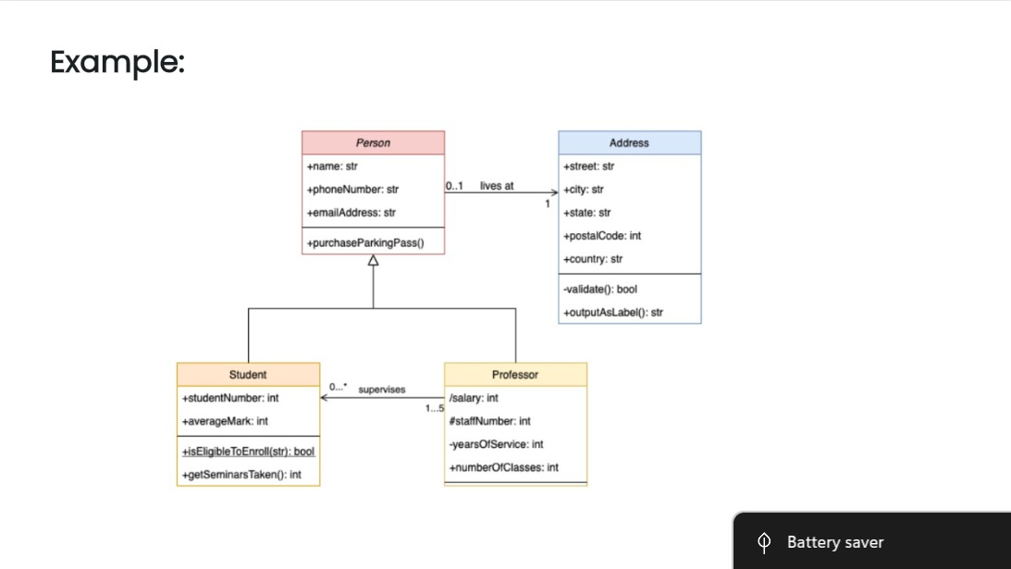

Slide 23
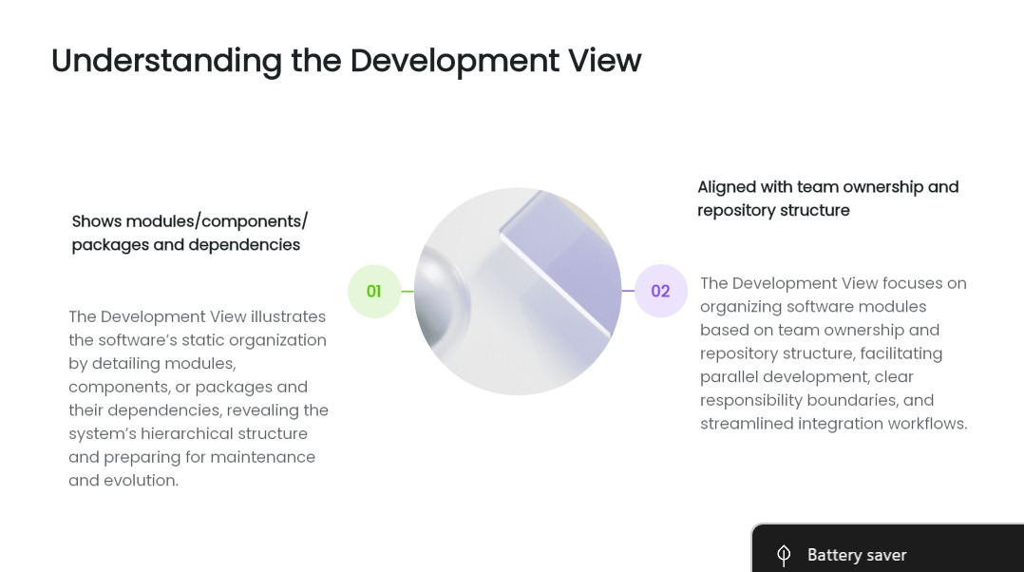

Slide 24
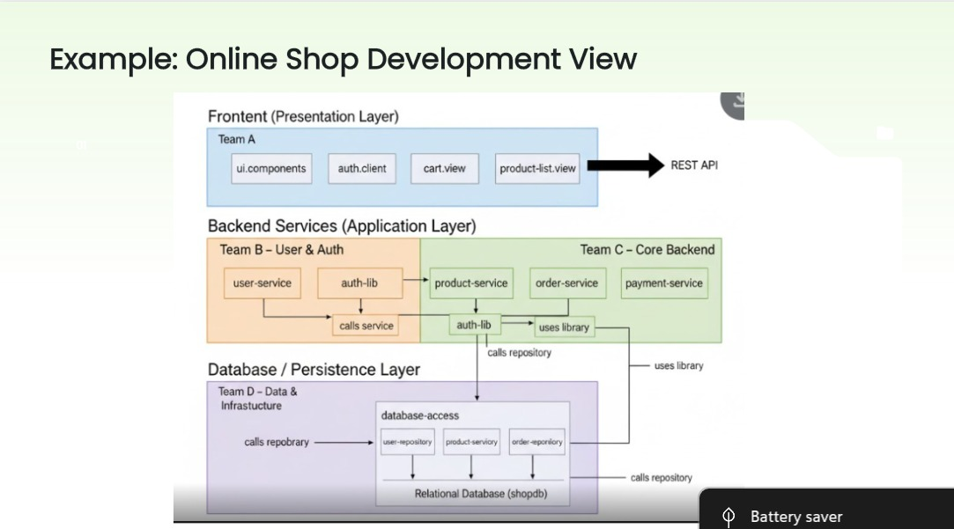

Slide 25
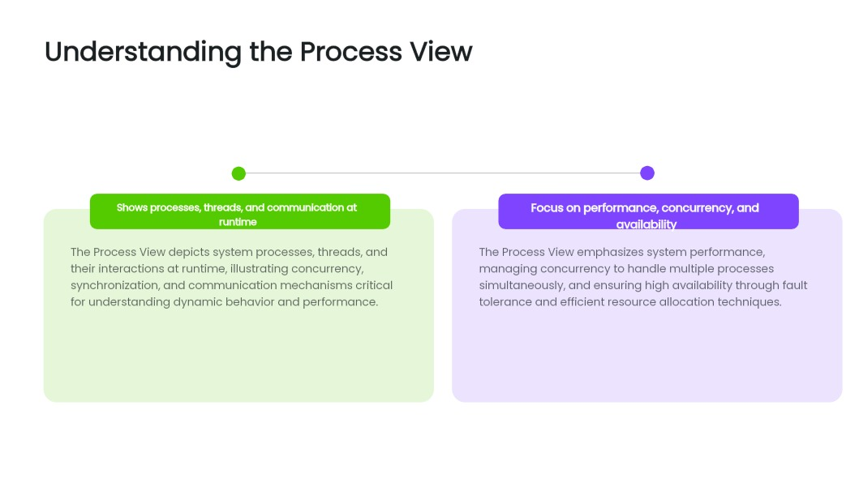

Slide 26
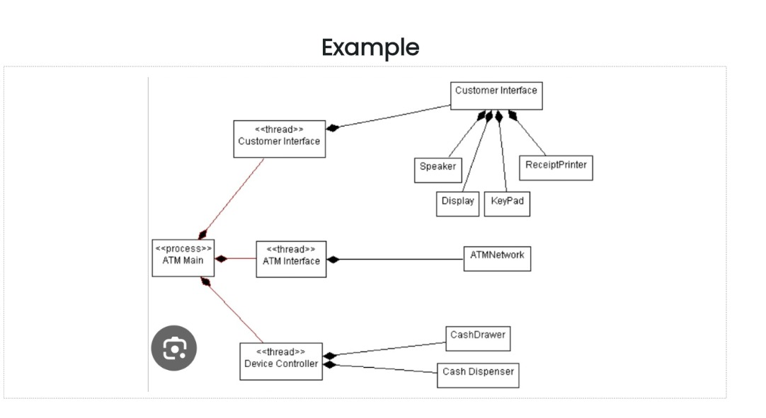

Slide 27
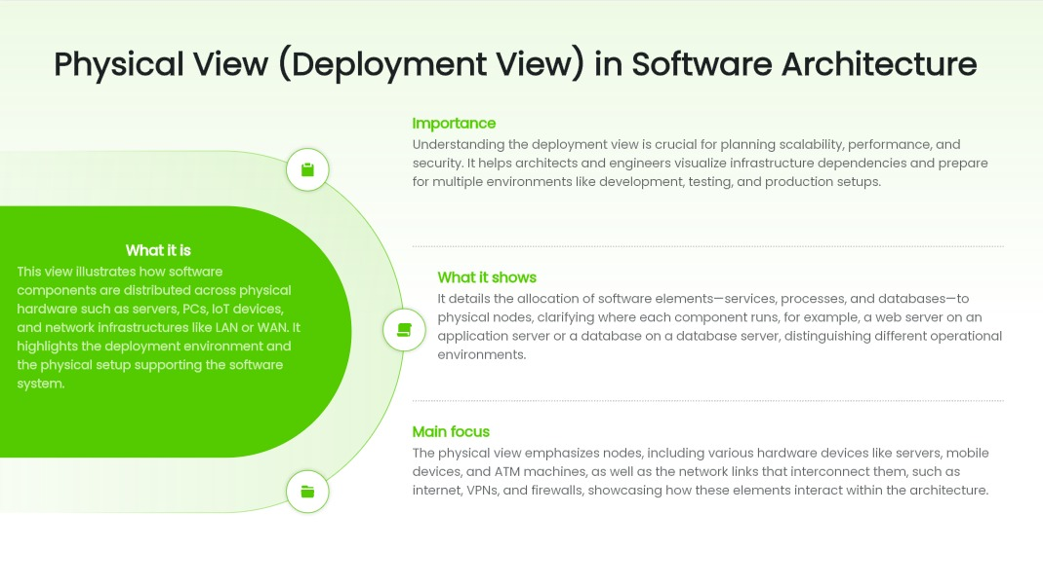

Slide 28
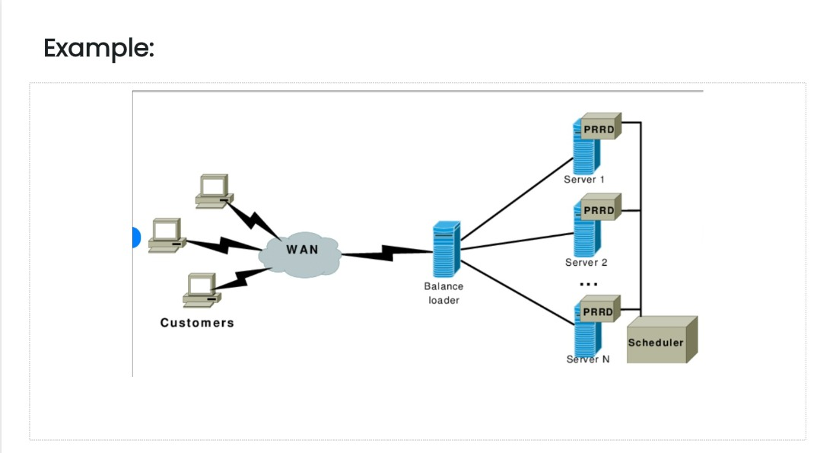

Slide 29


